Slide 1
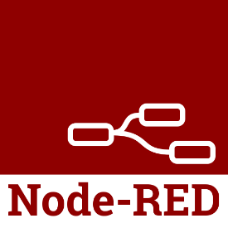
Node-RED
What is it, and what can you do with it?

Slide 2












Karl-Henry Martinsson
Programming since 7th grade
In the IT industry for 35 years
Software Developer/Architect
Owner of Demand Better Solutions
Part-time digital nomad
Karl-Henry Martinsson
2013-2023
2016-2023
2014-2020
2019-2023

Slide 3
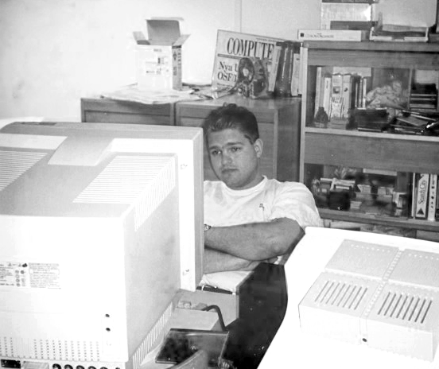
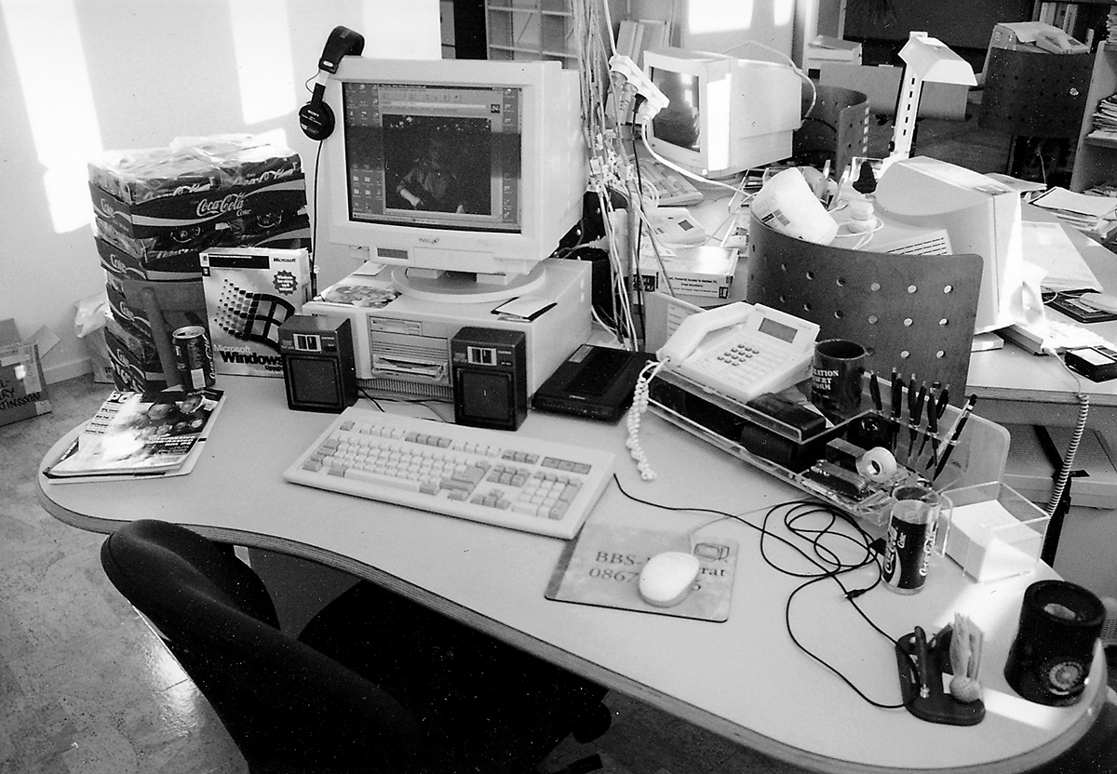

35 Years in IT
Support Engineer
Microsoft AB
Audiotex Engineer
Voice Equipment
Journalist & Test Editor
IDG Sweden
Lotus Notes Developer
IDG Boston
Senior Developer
Deep South
Senior Consultant
The Vested Group
Master Consultant
Wipfli

Slide 4

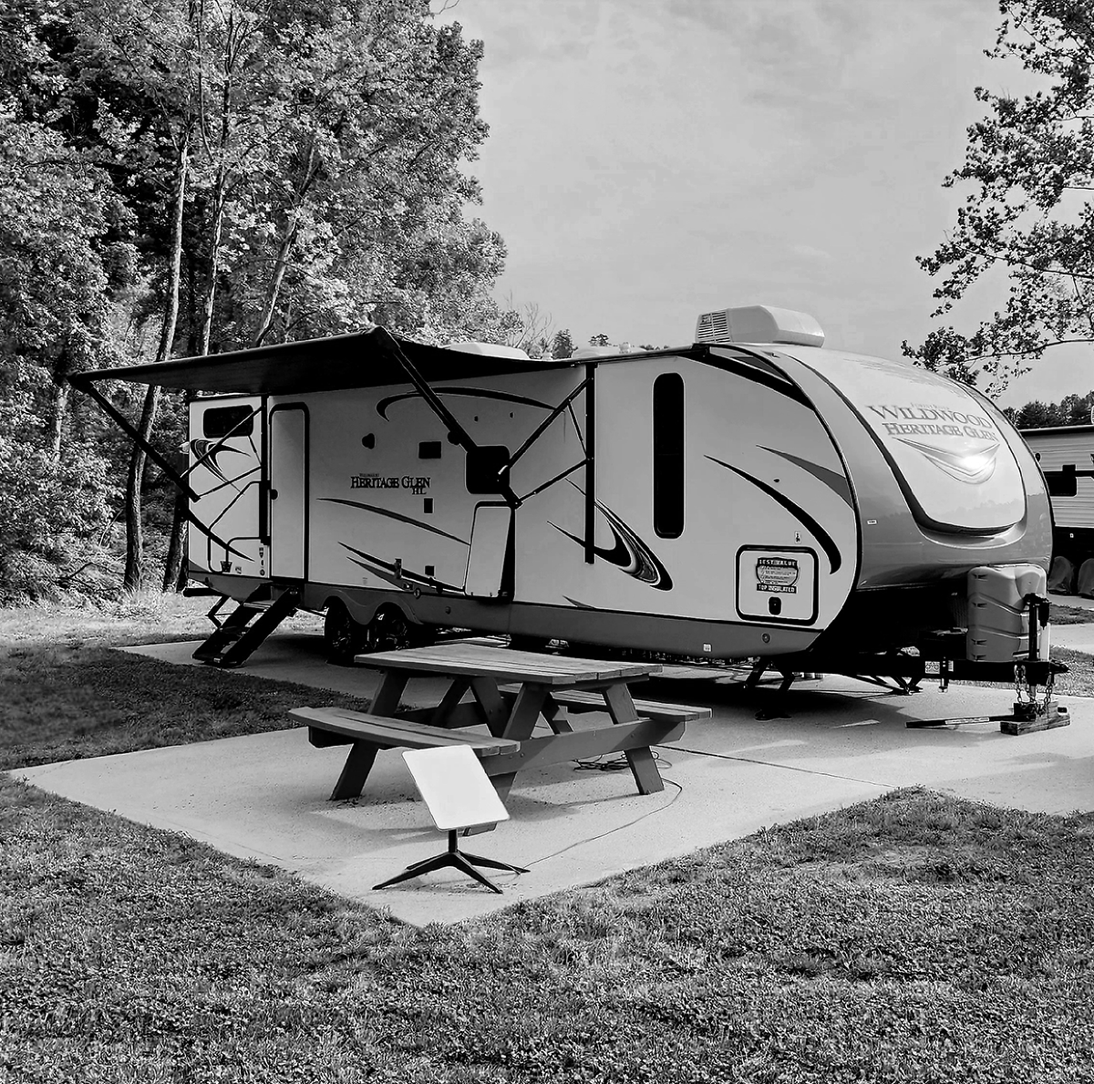

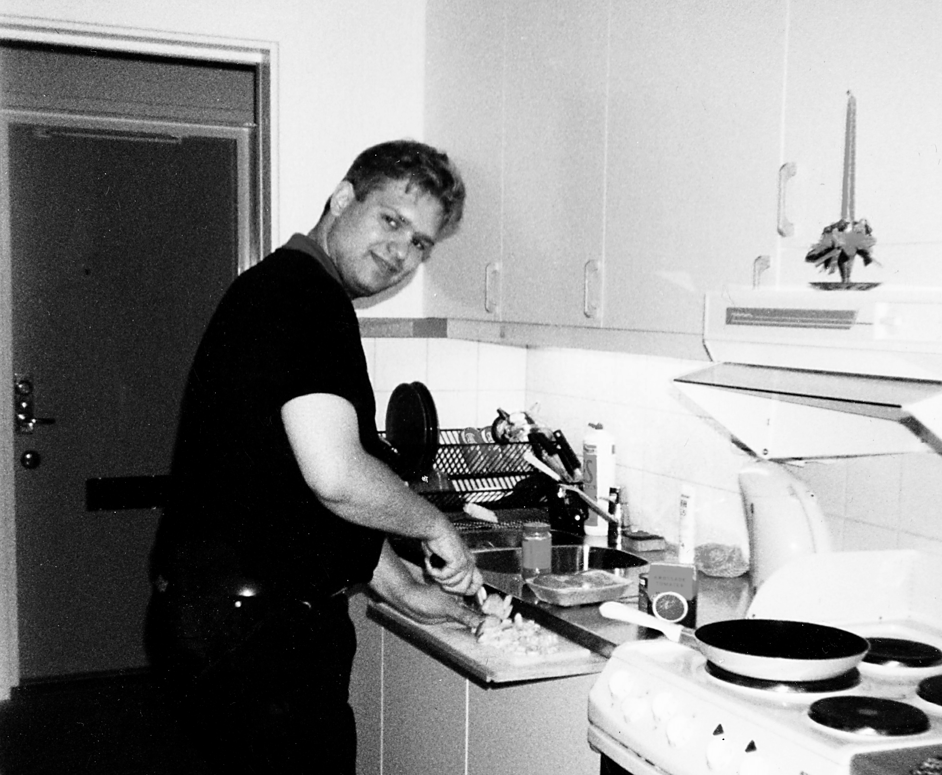






Hobbies & Interests
RV & Camping
Traveling
SCUBA diving
Woodworking
Cooking & Baking
Programming
Electronics
Shooting

Slide 5


Consulting Business
Modern UX and UI
Make software easy to use
Modern Applications
New development
Modernize existing apps
Data migration
Modern Technologies
Web browser
Notes client
Integration with Domino
REST API
Javascript/jQuery
REST
Mobile
Web Services
HCL Nomad
React Native
Custom mobile Domino
Node.js
Increase user satisfaction
Boost adaptation by users
Improve productivity
Reduce stress and burnout
Clean and efficient UI
Easy to find functions
Instinctual design
HCL Notes & Domino
To the user the UI is the application!
Domino
v12 now supported!

Slide 6

Agenda
1
What is Node-RED?
2
Building a simple Node-RED flow
3
Translation (English to Spanish) using IBM Watson
4
Integrate Node-RED into your own solutions
5
Domino Flows using the AppDev Pack

Slide 7

What is Node-RED?
Low-Code Development Platform
Originally created by IBM, open source since 2016
“Flow-based programming for IoT”
Wire together services, APIs and hardware
One-click deployment
Built on Node.js
Light-weight runtime, can even run on a Raspberry Pi
Available as Docker container
Hosted on IBM Cloud, Azure & AWS

Slide 8
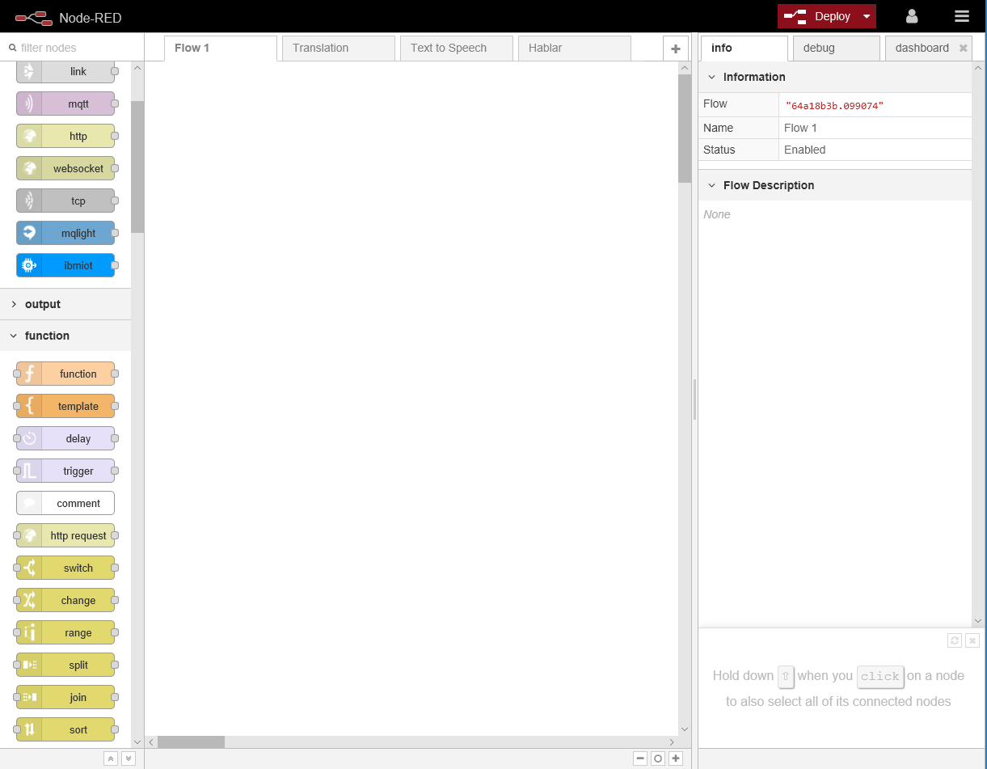
Easy Development
Browser-based editor
Click-and-drag of components
Input and output nodes
http, web sockets, email, twitter
Function nodes
switch, split, join, change
Javascript used to modify data
No expert skills needed
Beginner friendly

Slide 9
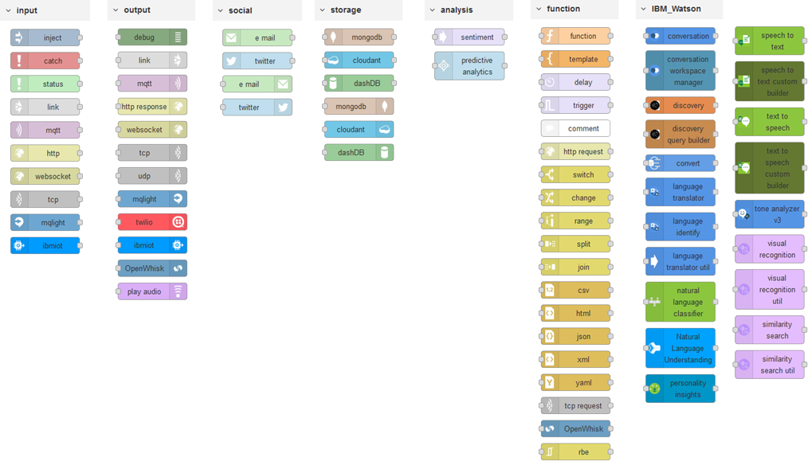
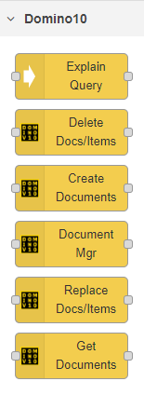
Many Available Nodes
Available for
Domino 10!

Slide 10
The Node
Messages passed between nodes
Javascript object named msg
Default property for most nodes: payload
Using _msgid to trace progress through a flow
Javascript used in nodes to modify payload
msg from previous node
{
"_msgid": "123456",
"payload": {
"firstname": "Karl-Henry",
"lastname":" "Martinsson",
"age": 50
}
}
msg to next node
Javascript used to
modify payload
{
"_msgid": "123456",
"payload": "Welcome, Karl-Henry Martinsson"
}

Slide 11

A Simple Flow
Create and deploy our first Node-RED flow in IBM Cloud

Slide 12
Some Popular Nodes
node-red-node-email
Node-RED nodes to send and receive simple emails.
node-red-node-ping
Node-RED node to ping a remote server, for use as a keep-alive check.
node-red-contrib-play-audio
A node for playing audio in the browser.
node-red-node-mysql
Node-RED node to read and write to a MySQL relational database.
node-red-contrib-bigtimer
The ultimate Node-Red Timer with dusk, dawn (and variations inc. sunrise, sunset, moonrise and moonset), months, days, manual override, schedule pause, random or fixed offsets, special days and much more.
node-red-contrib-moment
Node that produces formatted Date/Time output usingMoment.js library.
node-red-contrib-cron-plus
A flexible scheduler (cron, solar events, simple dates) with full dynamic control and time zones.
node-red-node-fs-ops
A node to perform basic file system operations.
node-red-contrib-browser-utils
Node-RED nodes for browser functionality such as file upload, camera & microphone.
node-red-contrib-oauth2
Node-RED node that provides an OAuth2 authentication flow. This node uses the OAuth2 protocol to obtain an access token, which can be used to make authenticated API requests.

Slide 13

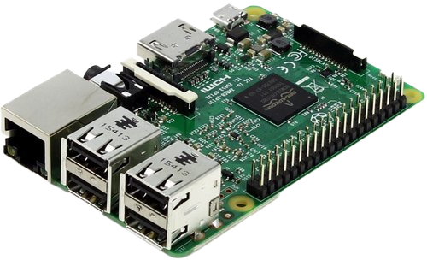
Node-RED on Raspberry Pi
$35 Single Board Computer
1GB to 8GB RAM (depending on model)
Low power consumption
GPIO pin-out for hardware expansion
Micro-SD slot for memory
Ethernet and USB ports
Wi-Fi on most models
Linux-based operating systems

Slide 14
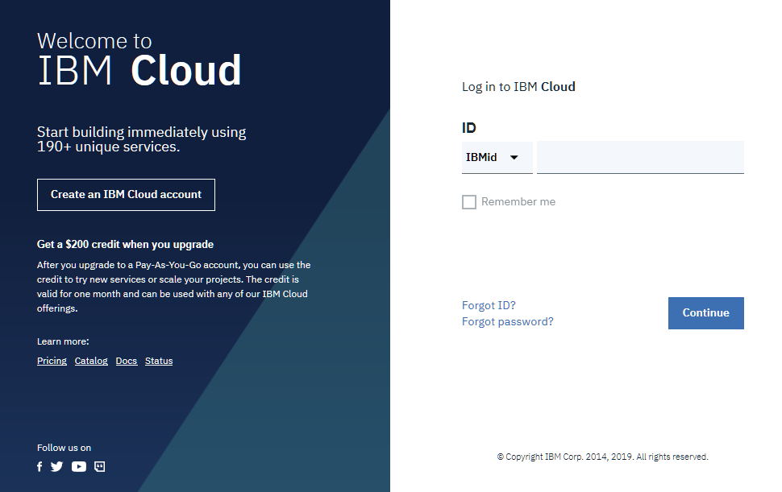
Connect to IBM Cloud
IBM Watson Translation Service
Hosted on IBM Cloud
Free accounts available
Many other services available
Text-to-Speech
Visual Recognition
Databases

Slide 15
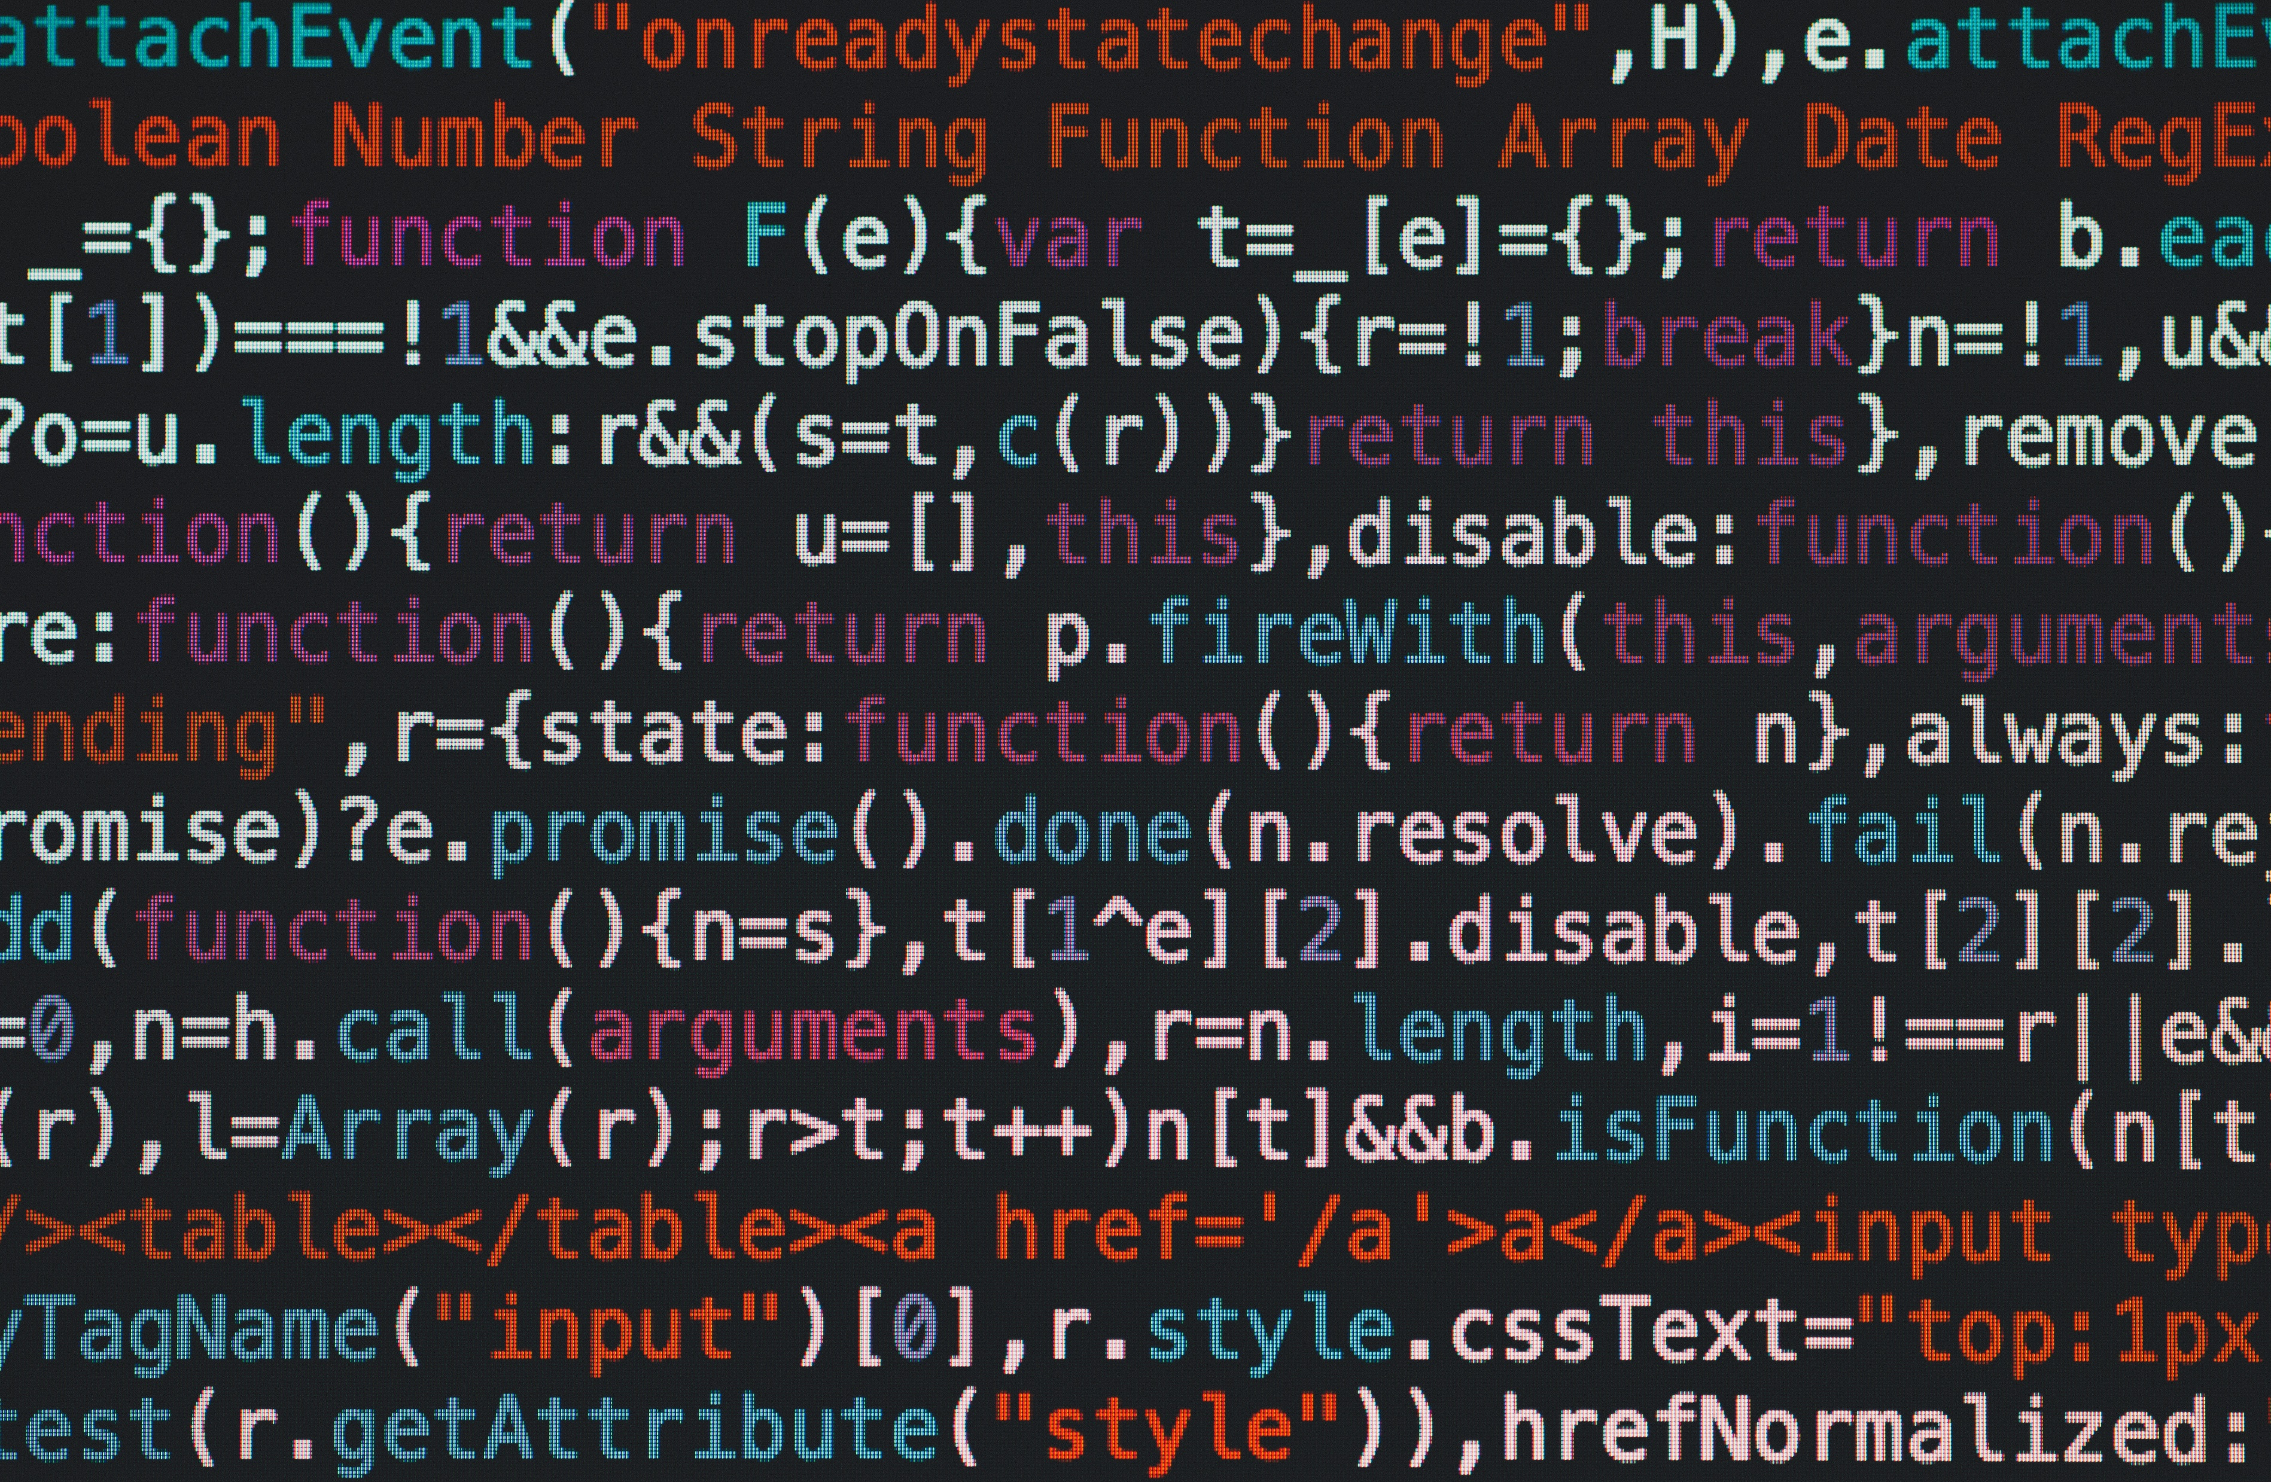
Website
Node-RED using IBM Watson to translate in the web browser

Slide 16

Domino Can Too!
NotesHTTPRequest class in Domino 10
Had to create your own in pre-10 versions
Dim webRequest As NotesHTTPRequest
Dim response As String
Set webRequest = session.CreateHTTPRequest()
response = webRequest.get(url)
Note: There is an error in the HCL documentation.
The get() method returns a string, not a variant.

Slide 17
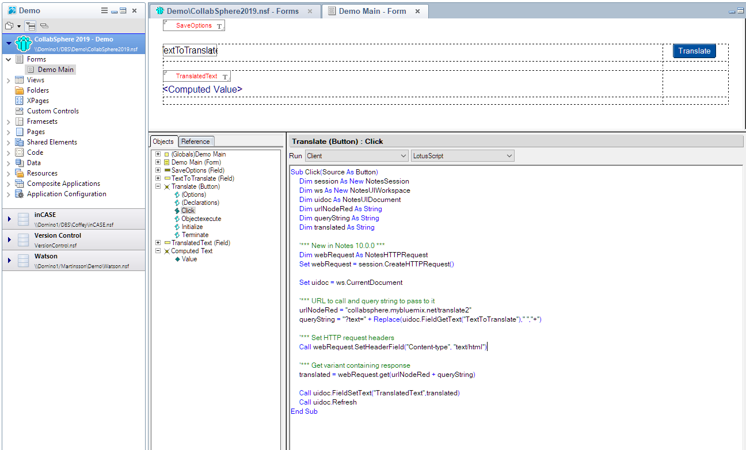
Domino Designer
Could it really
be this easy?
Yes!
Create a form
Three fields:
Text to translate
Translated text coming back (hidden)
SaveOptions field with value "0" (hidden)
Computed text
Button with code
Add a few lines of Lotusscript code
Call Node-RED and read response
Store response in hidden field
Display as computed text

Slide 18

The Lotusscript Code
Sub Click(Source As Button)
Dim session As New NotesSession
Dim ws As New NotesUIWorkspace
Dim uidoc As NotesUIDocument
Dim urlNodeRed As String
Dim queryString As String
Dim translated As String
'*** New in Notes 10.0.0 ***
Dim webRequest As NotesHTTPRequest
Set webRequest = session.CreateHTTPRequest()
Set uidoc = ws.CurrentDocument
'*** Specify URL and build query string
urlNodeRed = “texasswede.mybluemix.net/translate2"
queryString = "?text=" + Replace(uidoc.FieldGetText("TextToTranslate")," ","+")
'*** Set HTTP request headers
Call webRequest.SetHeaderField("Content-type", "text/html")
'*** Get string containing response from Node-RED
translated = webRequest.get(urlNodeRed + queryString)
'*** Update hidden field and then refresh form
Call uidoc.FieldSetText("TranslatedText",translated)
Call uidoc.Refresh
End Sub
There is an error
in the HCL documentation.
The get() method returns
a string, not a variant.

Slide 19
Notes Client
Node-RED using IBM Watson to translate in the Notes Client

Slide 20
Domino Flows for Node-RED
Access Domino documents from Node-RED

Slide 21

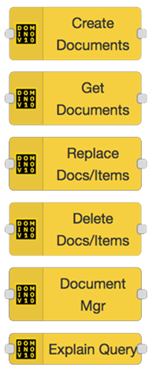
The Demo Environment
Node-RED with Domino 10 Flows
CRUD¹
Document Manager
Explain Query
Domino 10
Server 10.0.1 with FixPack 2+
AppDev Pack 1.0.2
SSL² certificate
Client Authentication
Server 10.0.2 or later
¹ Create, Read, Update, Delete
² Secure Socket Layer

Slide 22

The AppDev Pack
Sounds like a pain!
It is, but it’s worth it!
The Power User account can control
all of the integration on behalf oF
your users, running securely on
your Domino server, without the
need to pass a username or
password in your REST calls.
AppDev Pack SSL
Server configuration
Power User configuration
Add Power User to ACL of each database
Add Power User client certificate and key
DQL Configuration

Slide 23
Domino CRUD
Create, Read, Update, and Delete in Domino using Node-RED

Slide 24

Summary
Open-Source Low-Code platform
Can be easily and cheaply hosted
Browser-based editor
Click & drag components and connections
Connect services, APIs and hardware
Javascript used to modify data in flows
Many nodes, now also Domino Flows
Focus on logic and process, not code

Slide 25
Questions?

